Slide 1
Algorithms Depth-first and breadth-first search
CSE 464/574
Spring 2019

Slide 2
Depth-first search
Goal. Systematically traverse a graph. Idea. Mimic maze exploration.
Typical applications.
Find all vertices connected to a given source vertex.
Find a path between two vertices.
Design challenge. How to implement?
DFS (to visit a vertex v)
Mark v as visited.
Recursively visit all unmarked vertices w adjacent to v.

Slide 3
Depth-first search
To visit a vertex v :
Mark vertex v as visited.
Recursively visit all unmarked vertices adjacent to v.
Demo: https://www.cs.usfca.edu/~galles/visualization/DFS.html

Slide 4
Design pattern for graph processing
Design pattern. Decouple graph data type from graph processing.
Create a Graph object.
Pass the Graph to a graph-processing routine.
Query the graph-processing routine for information.
public class Paths {
Paths( Graph G, in s) // find paths in G from source s
Boolean hasPathTo( int v) // s there a path from s to v?
Iterable<Integer> pathTo( int v ) // path from s to v; null if no such path
}
Paths paths = new Paths(G, s);
for (int v = 0; v < G.V(); v++)
if (paths.hasPathTo(v)) // print all vertices connected to s
StdOut.println(v);

Slide 5
Depth-first search: data structures
To visit a vertex v :
Mark vertex v as visited.
Recursively visit all unmarked vertices adjacent to v.
Data structures.
Boolean array marked[] to mark visited vertices.
Integer array edgeTo[] to keep track of paths. (edgeTo[w] == v) means that edge v-w taken to visit w for first time
Function-call stack for recursion.

Slide 6
Depth-first search: Java implementation
public class DepthFirstPaths
{
private boolean[] marked;
private int[] edgeTo;
private int s;
private void dfs(Graph G, int v)
{
marked[v] = true;
for (int w : G.adj(v))
if (!marked[w])
{
dfs(G, w);
edgeTo[w] = v;
}
}
marked[v] = true if v connected to s
edgeTo[v] = previous vertex on path from s to v
public DepthFirstPaths(Graph G, int s)
{
...
dfs(G, s);
}

Slide 7
Depth-first search: properties
Proposition. DFS marks all vertices connected to s in time proportional to the sum of their degrees (plus time to initialize the marked[] array).
Proof: [correctness]
First show that, If w marked, then w is connected to s:
From an examination of the code, the only way to get to the “marked[v] = true;” statement is by following edges [ that is, elements of the G.adj(v) array ]
Thus, w is marked only of it is connected to s

Slide 8
Next, show that if w connected to s, then w marked
By contradiction. Supposed that w is connected to s, but is not marked.
Then consider last edge on a path from s to w that goes from a marked vertex to an unmarked one. This edge would be in the adj array. Thus, it would eventually be followed and the vertex marked.

Slide 9
Depth-first search: properties
Proof: [running time]
Each vertex connected to s is visited once.
A vertex could not have been visited more than once since it is protected by the !marked[w] Boolean condition
No vertex can be missed since we loop through all of the adj array that includes all of the vertices.

Slide 10
Depth-first search: properties
Proposition. After DFS, we can check if vertex v is connected to s in constant time and can find v–s dfs path (if one exists) in time proportional to its length.
Proof: edgeTo[] is parent-link representation of a tree rooted at vertex s.
public Iterable<Integer> pathTo(int v)
{
if (!hasPathTo(v)) return null;
Stack<Integer> path = new Stack<Integer>();
for (int x = v; x != s; x = edgeTo[x])
path.push(x);
path.push(s);
return path;
}
public boolean hasPathTo(int v)
{ return marked[v]; }

Slide 11
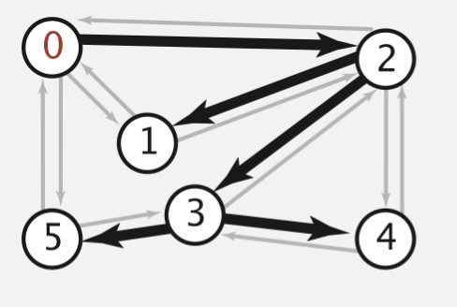
Depth-first search: properties
adj array
edgeTo[]
0
1
2
3
4
5
1 | 2 | 5
0
1 | 2
2 | 0
3 | 2
4 | 3
5 | 3
2
0 | 1 | 3 | 4
2 | 3 | 5
2 | 3
0 | 3

Slide 12
Breadth-first search
Repeat until queue is empty:
Remove vertex v from queue.
Add to queue all unmarked vertices adjacent to v and mark them.
Demo: https://www.cs.usfca.edu/~galles/visualization/BFS.html

Slide 13
Breadth-first search
BFS (from source vertex s)
Put s onto a FIFO queue, and mark s as visited.
Repeat until the queue is empty:
- remove the least recently added vertex v
- add each of v's unvisited neighbors to the queue, and
mark them as visited.

Slide 14
Breadth-first search: Java implementation
private void bfs(Graph G, int s) {
Queue<Integer> q = new Queue<Integer>();
q.enqueue(s);
marked[s] = true;
distTo[s] = 0;
while (!q.isEmpty()) {
int v = q.dequeue();
for (int w : G.adj(v)) {
if (!marked[w]) {
q.enqueue(w);
marked[w] = true;
edgeTo[w] = v;
distTo[w] = distTo[v] + 1;
}
}
}
}
public class BreadthFirstPaths
{
private boolean[] marked;
private int[] edgeTo;
private int[] distTo;
…

Slide 15
Breadth-first search properties
Question: In which order does BFS examine vertices?
Answer: Increasing distance (number of edges) from s.
queue always consists of ≥ 0 vertices of distance k from s, followed by ≥ 0 vertices of distance k+1
Proposition. In any connected graph G, BFS computes shortest paths from s to all other vertices in time proportional to E + V.

Slide 16
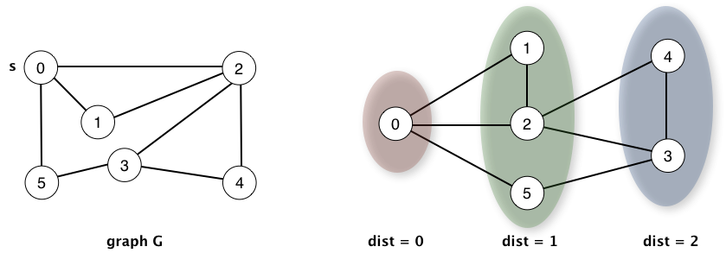

Slide 17
Breadth-first search application:
Routing: Fewest number of hops in a communication network.
Kevin Bacon numbers
Include one vertex for each performer and one for each movie.
Connect a movie to all performers that appear in that movie.
Compute shortest path from s = Kevin Bacon.
Erdös numbers

